Slide 1
Spectre Memory Estimation
Jiali Lv
6/18/2019
Cadence confidential, internal use only

Slide 2

The Problem
The Model
Conclusion
Agenda
Feature Extraction
Results
Future Works

Slide 3
The Problem

Slide 4
When users simulating large circuits with Spectre, it needs numerous memory usage. For reasonable arrangement of simulating plans, it’s necessary for them to estimate memory usage before analysis.
Simulators are highly complex: it includes complex mathematical operations, different modes (accuracy/speed tradeoff), hundreds of options, etc. All of those will influence Spectre’s memory usage.
Hence we want to estimate Spectre global peak memory usage after Spectre "EDB Visiting" stage in APS mode by using a machine learning model. In this way, we proposed an automated mechanism to assist the users of the Spectre.

Slide 5




Users
Simulators
The inadequate simulator setup affects the validity of simulation (or even its success)

Slide 6
Proposal: a decision support (validation) system by estimating Spectre global peak memory usage

Slide 7
Machine learning algorithms can be classified into two groups based on the way they “learn” about data to make predictions: supervised and unsupervised learning.
Supervised learning problems can be further grouped into Regression and Classification problems. The difference between the two tasks is the fact that the dependent attribute is numerical for regression and categorical for classification.
We can conclude that memory estimation is supervised learning and regression problem.

Slide 8
Feature Extraction

Slide 9
selected
Because we focus on estimating memory with large circuits, we selected 351 cases from 923 APS performance cases, excluding errored cases, cases without transient analysis and cases less than 500 Mbytes.

Slide 10
Information about memory usage before simulation
( … )
*************************************************
Time for EDB visiting: CPU = 1.15 s, elapsed = 1.20 s.
Time accumulate used: CPU = 1.34 s, elapsed = 2.94 s.
Peak resident memory used = 386 Mbytes.
( … )
spectre.out
Choose peak resident memory after EDB visiting as one of features

Slide 11
Information about memory usage before simulation
Information about the circuit
( … )
Circuit inventory:
nodes 51153
bsim3v3 2
bjt 10
bsim4 41244
resistor 6
tmibsim 15
capacitor 24922
diode 2443
mos 1213
inductor 9
bsource 12
vsource 414
juncap 4
model_ibias 2
model_inv 6
model_or2 48
model_osc_phases 3
model_res_load 1
relay 1
vcvs 4
( … )
spectre.out
Choose 13 inventory items as features
(Some of features are from internal log)

Slide 12
Information about memory usage before simulation
Information about the circuit
Information about the simulation
spectre.out
Choose global peak memory as estimation target
( … )
Aggregate audit (10:36:17 PM, Thur Mar 15, 2019):
Time used: CPU = 134 ks (1d 13h 5m), elapsed = 29.4 ks (8h 9m 43s), util. = 454%.
Time spent in licensing: elapsed = 74.7 ms.
Peak memory used = 616 Mbytes.
Simulation started at: 2:26:33 PM, Thur Mar 15, 2019, ended at: 10:36:17 PM, Thur Mar 15, 2019, with elapsed time (wall clock): 29.4 ks (8h 9m 43s).
spectre completes with 0 errors, 145 warnings, and 28 notices.
Choose cases with 0 errors as training cases

Slide 13
The Model

Slide 14
First idea: Linear Regression
We use Python scikit-learn module to train model and finally get it as follow:
peakMemory = 1.11e6 * sfeMemory + 4.21e3 * nodenum - 9.98e4 * bjtnum +
2.16e3 * bsim3v3num + 5.62e2 * capacitornum - 4.83e2 * diodenum -
6.62e1 * resistnum - 5.61e3 * vsourcenum - 5.66e3 * bsourcenum -
3.07e3 * inductornum - 5.80e4 * mosnum + 2.39e3 * bsim4num +
4.97e4 * tmibsimnum + 1.32e4 * juncapnum
However the accuracy is 69.2% which is far below our target accuracy. It seems linear regression may not be suitable for our APS data.

Slide 15
Second idea: Random Forest
Random forest is an ensemble learning method for classification, regression and other tasks that operates by constructing a multitude of decision trees at training time and outputting the class that is the mode of the classes (classification) or mean prediction (regression) of the individual trees.
After training, we get random forest model:
* train dataset’s mean absolute error: 6.24 %
* test dataset’s mean absolute error: 11.40%
Although it seems that dataset’s error is excellent, there are some problems as well:
* Test dataset’s error is much higher than train dataset’s, maybe the model is overfitting;
* Because our dataset’s global memory range from 0.5 to 30 GBytes and random forest can’t predict data outside the range of training dataset well, if we want to estimate memory larger than 30 GBytes using random forest model, it will have poor results.

Slide 16
Therefore, we consider about Neural Network :
Neural network is a network of simple elements called artificial neurons, which receive input, change their internal state (activation) according to that input, and produce output depending on the input and activation. The network forms by connecting the output of certain neurons to the input of other neurons forming a directed, weighted graph. The weights as well as the functions that compute the activation can be modified by a process called learning which is governed by a learning rule. It can achieve better results than Random Forest when part of data is missing or lacking in the training dataset.

Slide 17























$a_{n}^{\left\langle l\right\rangle }$ Activation of the $n$^{th} unit of layer $l$
Hidden Unit
Hidden Neuron
Input Unit
Input Neuron
Feature
$a_{0}^{\left\langle 0\right\rangle }$
Activation
$$x_{0}$$
$a_{0}^{\left\langle 2\right\rangle }$
$A^{\left\langle l\right\rangle }$ Activation Vector
at layer $l$
$a_{0}^{\left\langle 1\right\rangle }$
$a_{1}^{\left\langle 0\right\rangle }$
$$x_{1}$$
$a_{1}^{\left\langle 2\right\rangle }$
$$X$$
$$\hat{Y}$$
$a_{2}^{\left\langle 0\right\rangle }$
$a_{1}^{\left\langle 1\right\rangle }$
$a_{0}^{\left\langle 3\right\rangle }$
Output or Estimation
(of $Y$, the True Label)
Input Vector
$$x_{2}$$
$a_{2}^{\left\langle 2\right\rangle }$
$$X=\left[\begin{matrix}\begin{matrix}x_{0} \\ x_{1}\end{matrix} \\ \begin{matrix}x_{2} \\ x_{3}\end{matrix}\end{matrix}\right]$$
$a_{2}^{\left\langle 1\right\rangle }$
$$x_{3}$$
$a_{3}^{\left\langle 2\right\rangle }$
Output Unit
Output Neuron
$a_{3}^{\left\langle 0\right\rangle }$
Input Layer
Hidden Layers
Output Layer

Slide 18











$A^{\left\langle 0\right\rangle }=X$
$$A^{\left\langle 1\right\rangle }$$
$W^{\left\langle l\right\rangle }$ Weight Vector at layer $l$
$$Φ$$
$A^{\left\langle l\right\rangle }$ Activation Vector at layer $l$
$$W^{\left\langle 1\right\rangle }$$
$B^{\left\langle l\right\rangle }$ Biases at layer$l$
$Φ(x)$ non-linear function
General form of a layer Activation:
$$A^{\left\langle l\right\rangle }=Φ\left(W^{\left\langle l\right\rangle }∗A^{\left\langle l−1\right\rangle }+B^{\left\langle l\right\rangle }\right)$$

Slide 19
Considering that it’s a heavy way to integrate traditional neural network module like Tensorflow into Spectre, we choose Python machine learning library -- Scikit-Learn. It features various classification, regression and clustering algorithms including Multi-layer Perceptron Neural Network. When Spectre running with “+aps +query=meminfo”, it will call the Python code to print the estimated result.

Slide 20

Data preprocessing
Multi-layer Perceptron is sensitive to feature scaling, so it is recommended to scale data. For example, scale each attribute on the input vector X to [0, 1]. We can use sklearn.MaxMinScaler for standardization.
Features:
# sfeMemory
# nodes
# bsim3v3
# bjt
# bsim4
# resistor
# tmibsim
# capacitor
# diode
# mos
# inductor
# bsource
# vsource
# juncap
12.541012
1504646
16
0
2655832
394
2102480
22
40013
10
0
63228
0
0
0.6643249
0.6532487
0.0038040
0.0
1.0000033
0.0025105
0.3874325
5.0995e-05
2.4238551
0.0001261
0.0
0.0346995
0.0
0.0
x =
transform
x_scaled$=\frac{\text{x}\text{[}\text{i}\text{]−}\text{x}\text{_}\text{min}\text{[}\text{i}\text{]}}{\text{x}\text{_}\text{max}\text{[}\text{i}\text{]−}\text{x}\text{_}\text{min}\text{[}\text{i}\text{]}}$
x_scaled =

Slide 21



Hidden Layer 1
28 “Neurons”
2584 trainable parameters
Hidden Layer 9
9 “Neurons”
$$\hat{Y}$$
Prediction
$$X=\left[\begin{matrix}\begin{matrix}x_{0} \\ x_{1}\end{matrix} \\ \begin{matrix}⋮ \\ x_{13}\end{matrix}\end{matrix}\right]$$
Fully Connected Layers
Hidden Layers with “reLu” activation
Number of neurons in each hidden layer: 28, 28, 14, 14, 14, 14, 6, 6, 9

Slide 22
Categorical Cross-entropy
Adam Optimization
Test – 15%
300 Epochs
Batch size of 128
Validation – 17%
Train – 68%
351 cases

Slide 23
Results

Slide 24
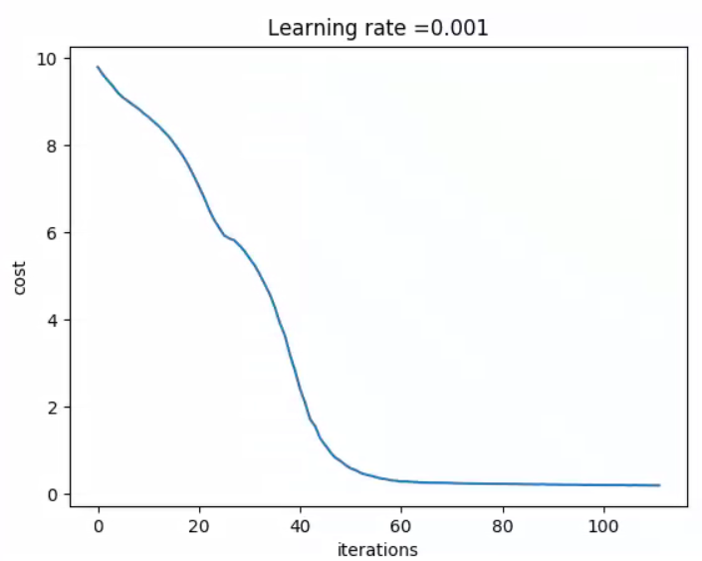
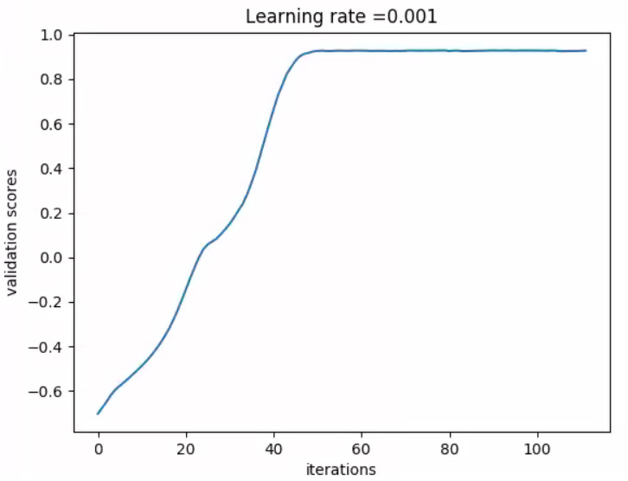
After 100 iterations of training, Categorical cross-entropy loss arrives at 0.23 and validation score arrives at 0.92.
Training dataset mean absolute error: 15.70 %
Testing dataset mean absolute error : 16.16 %

Slide 25
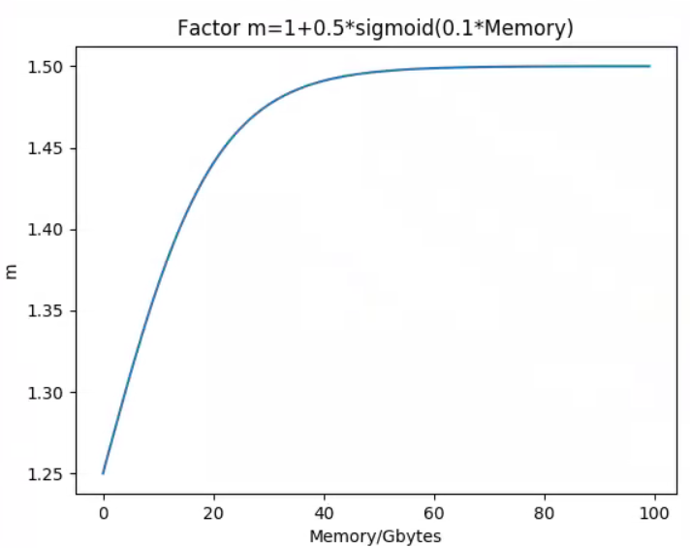
We hope that in most cases the estimated memory is larger than the actual memory. If the estimated memory is less than the actual memory, the user’s decision will be affected incorrectly. To avoid this, we can give a recommended memory reservation that is equal to the estimated memory multiplied by a factor m.
We can choose a factor which can make 95% recommended memory larger than the actual memory to satisfy the need. In fact, it’s better that as the memory gets larger, the factor gets larger. So we choose a memory-related function to determine the factor m.

Slide 26
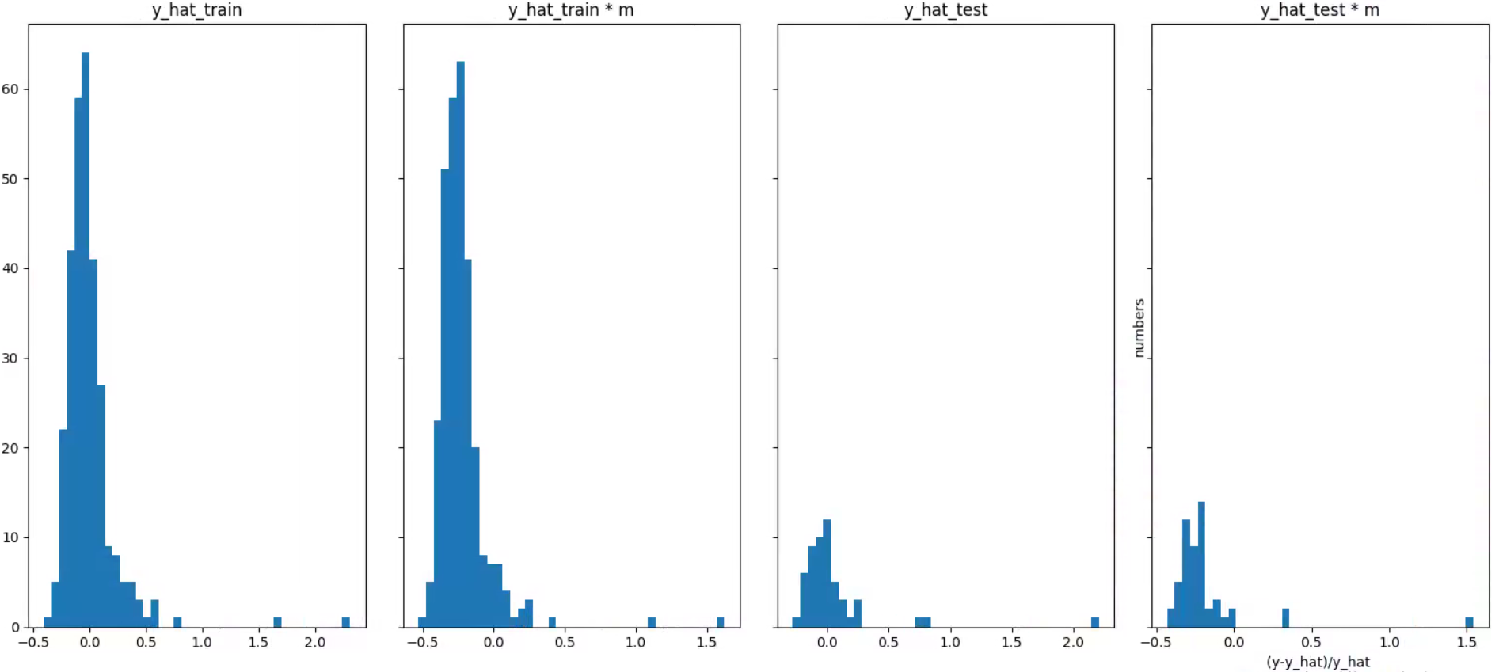
In below picture, y axis is the number of cases and x axis is “(y-y_hat)/y_hat”, where “y” means the actual memory and “y_hat” means the predicted memory. If “(y-y_hat)/y_hat” is greater than zero, it means the predicted memory is less than the actual memory.
(1) and (3) are error distributions of training/testing datasets; (2) and (4) are error distributions of training/testing datasets after the predicted memory multiplied by a factor. We can see that 95% recommended memory (predicted memory multiplied by a factor) is larger than the actual memory.

Slide 27



The result of memory estimation will be printed to screen and Spectre log, as shown in the blue rectangle.
The estimated memory usage before simulation
spectre.out
( … )
Time for parsing: CPU = 15.1667 s, elapsed = 17.8789 s.
Time accumulated: CPU = 159.053 s (2m 39.1s), elapsed = 172.242 s (2m 52.2s).
Peak resident memory used = 1.84 Gbytes.
~~~~~~~~~~~~~~~~~~~~~~
Pre-Simulation Summary
~~~~~~~~~~~~~~~~~~~~~~
~~~~~~~~~~~~~~~~~~~~~~
************************************************
Transient Analysis `tran': time = (0 s -> 20 ns)
************************************************
Notice from spectre during transient analysis `tran'.
The estimated memory usage is 2.54 Gbytes
Recommended memory reservation is 3.23 Gbytes
Total time required for tran analysis `tran': CPU = 53.992 ms, elapsed = 2.74 s.
Time accumulated: CPU = 159.135 s (2m 39.1s), elapsed = 175.014 s (2m 55.0s).
Peak resident memory used = 1.85 Gbytes.
Aggregate audit (1:25:44 AM, Wed Jun 19, 2019):
Time used: CPU = 162 s (2m 42.1s), elapsed = 178 s (2m 58.4s), util. = 90.8%.
Time spent in licensing: elapsed = 573 ms.
Peak memory used = 1.85 Gbytes.
Simulation started at: 1:22:45 AM, Wed Jun 19, 2019, ended at: 1:25:44 AM, Wed Jun 19, 2019, with elapsed time (wall clock): 178 s (2m 58.4s).
spectre completes with 0 errors, 13 warnings, and 42 notices..
$$\hat{y}$$
$\hat{y}$ * m

Slide 28
Conclusion

Slide 29
Using neural network model, we estimate global peak memory before transient analysis. Testing error on APS performance dataset achieves 16.16%. We also provide “recommended memory reservation” which is the predicted memory multiplied by a factor -- in 95% cases it will be larger than the actual memory, which helps users make resource arrangements.

Slide 30
Future Works

Slide 31
Because all of the cases come from same dataset and they may be different with customers’ cases, this memory estimation model need more validation and feedback from users.
Only transient analyses in APS mode was considered. For the next step, we can improve our model for more analyses and modes.
We are short on large cases, especially cases with peak memory >10 Gbytes. Since our application situation would be mostly on giant cases, the more cases we can get, the better accuracy we can achieve.
We may also consider about online learning method that user can train their own model in their actual working environment while simulating.

Slide 32
THANK YOU

